Slide 2
Message from Mentor |  | Page No. 4
Articles
Rethinking Leadership | Dr. Lalitha Balakrishnan | Page No. 5
Work Attitudes For Growth And Excellence | Ms. Fleur Fernandes | Page No.11
COVID-19, the Teacher of the Century!! | Dr. Swati Kulkarni | Page No.14
Details of Programs Organised |  | Page No.17
Glimpse of Programme |  | Page No. 18
Program Feedback |  | Page No 21
Advisory Board
• Dr. Vidhya Satish, Director, SIES Institute of Comprehensive Education, Sion (W).
• Dr. Uma Shankar, Principal, SIES(Autonomous) College of Arts, Science and Commerce, Sion (W)
• Dr. Nina Roy Choudhary, SIES College of Commerce and Economics, Sion (E)
• Dr. Bigyan Verma Director, SIES College of Management Studies, Navi Mumbai
Editorial Board
Ms. Suma Nair – Head, SIES Central Training
Dr. Vidhya Satish - Director, SIES Institute of Comprehensive Education

Slide 3
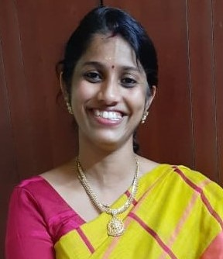
Greetings !
We are glad to present latest issue of Adhigam January to August 2021. The current issue brings interesting, informative articles and message from our mentor Dr. A K Sengupta. Our expert Dr. Lalitha B, Principal, MOP Vaishnav College for Women, Chennai a successful leader, educationist has shared inputs and experience on Leadership.
During the period, we have designed and conducted different webinar / online program on diverse topics to enhance competency of teaching, non-teaching staff and students. The program on 'Self-development- आपकी खुशी आपके हाथ में’ for support staff members were well appreciated by all. Webinar “COVINSIGHT - One Step Towards Physical and Emotional Well-Being” by Dr Manjeet Singh was arranged for staff, students and family members to address their query related COVID. The webinar was attended by 150 members through MS Team and others joined through YouTube link. The webinar reduced the anxiety level related to COVID . The five-day online workshop on “Advance Excel” by Prof Vidhya Rao was brought in good attendance by office staff.
Over seven years, SIES Central training department has organized program that were awareness oriented, technical and subject related programs. We are happy to share that there were more than 7000 beneficiaries.
The continuous guidance, support of management and all SIES institutions facilitated the learning initiatives and the e-newsletter-'Adhigam' to achieve its goal.
Happy Reading …..
Suma Nair – SIES Central Training
INSIGHT

Slide 4
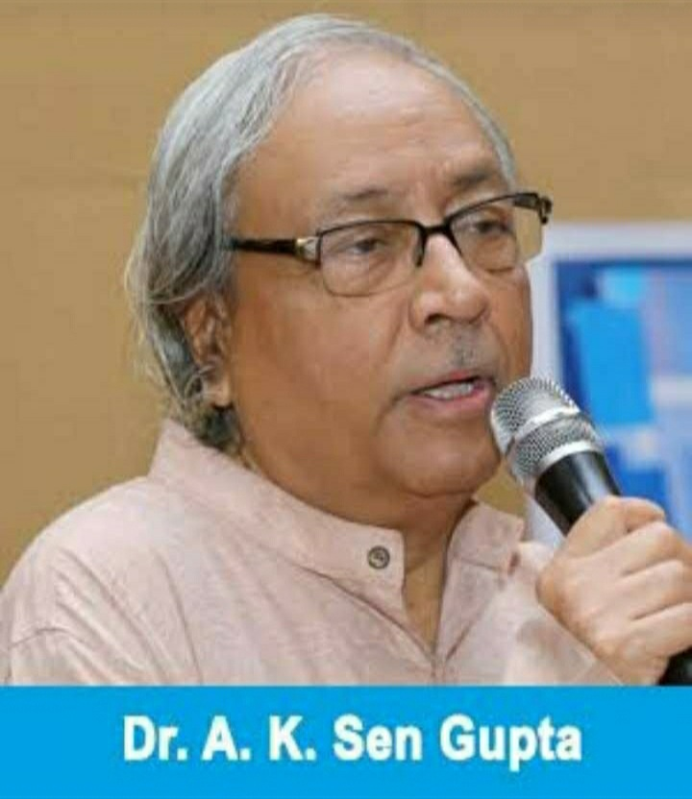
MESSAGE FROM MENTOR
Education sector is going through unprecedented times. Certain distinctive trends are, however, visible that will have long-term impact on the system and teachers at various levels.
First, NEP 2020 is likely to change contour of Indian education system starting from school to all strata of higher learning. Consequent to implementation of recommendations of NEP 2020, Indian education of future is going to be more internationally aligned and quality focused than at present with student community extra agile, equipped with life skills and exposed to multi-disciplinary liberal education. Focus on Indian values, culture and language will be sharper.
Second, with likely entry of foreign players, Indian education system will be further globally integrated in terms of internationalization of both students as well as faculty. There will also be substantive pressure on Indian counterparts to augment their quality of delivery. And finally, COVID 19 has brought out the new dimensions of virtual learning by making it a reality. Hybrid learning is going to be the new order of education process.
In the above context, role of teachers is going to be extremely crucial. If the system is to change and change for better, teachers are to be the catalyst for the same. We, therefore, need new generation teachers equipped with latest technological tools and ready to deliver simultaneously on-line as well as off-line student groups, who belong to different generation all together, to make them ready for future. Thus, we need new types of teachers with unique skills, tools / techniques but more importantly, a completely different attitude and mindset. To make Indian education system globally competitive, another area of focus is going to be creation of knowledge through scholarship of research and teachers are expected to facilitate the same.
We hope Indian teachers at all levels understand emerging reality and embrace the new order. They need to lead the change in education and thereby enhancing economic and social growth of the country to transform India into a real global hub of future.
A K SEN GUPTA

Slide 5
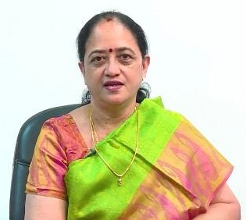
RETHINKING LEADERSHIP
DR. LALITHA BALAKRISHNAN,
PRINCIPAL, MOP VAISHNAV COLLEGE FOR WOMEN, CHENNAI
­­Leadership is the art of motivating a group of people to act toward achieving a common goal.
A leadership style is a leader's style of providing direction, implementing plans, and motivating people. It is the result of the philosophy, personality, and experience of the leader. Rhetoric specialists have also developed models for understanding leadership.
Leadership Styles
Different situations call for different leadership styles. In an emergency when there is little time to converge on an agreement and where a designated authority has significantly more experience or expertise than the rest of the team, an autocratic leadership style may be most effective; however, in a highly motivated and aligned team with a homogeneous level of expertise, a more democratic or laissez-faire style may be more effective.
The style adopted should be the one that most effectively achieves the objectives of the group while balancing the interests of its individual members.
An effective leader should be intellectually sound, conceptually brilliant and well versed in the said domain. The leader's intellectual capacity helps to conceptualize solutions and acquire knowledge to do the job. A leader's conceptual abilities apply agility, judgment, innovation, interpersonal tact, and domain knowledge. Domain knowledge for leaders encompasses tactical and technical knowledge as well as cultural and geopolitical awareness.
In the book Good to Great, Level 5 leaders are defined as those who display a powerful mixture of personal humility and indomitable will. They are incredibly ambitious, but their ambition is first and foremost for the cause, for the organization and its purpose, not themselves.
Contd………..

Slide 6
Contd…
The same book talks about the Hedgehog Concept – a simple, crystalline concept that flows from deep understanding about the intersection of three circles:
what you are deeply passionate about,
what you can be the best in the world at, and
what best drives your economic or resource engine.
Empathetic leadership – need of the hour
I also want to emphasize on the role empathy plays in leadership. Often times, we tend to confuse empathy with sympathy; that to be empathetic means agreeing or relating to the feelings another person has regarding a given situation or individual.
However, what empathy really means is being able to understand the needs of others. It means that you are aware of their feelings and how it impacts their perception. It does not mean that you have to agree with how they see things; rather, being empathetic means that you are willing and able to appreciate what the other person is going through.
There are tangible benefits that are derived from making time to understand what those around us need, as opposed to what we perceive is required. Indeed, leaders who take the time to understand the needs of their employees can provide them with the support they require to press ahead, to deal with the challenges or issues that might be holding them back from achieving their goals.
By understanding and providing employees with what they need to succeed, leaders can build a sense of trust, thereby strengthening the relationships they have with their employees and consequently, the relationships employees have with one another, leading to greater collaboration and improved productivity.
It is true that, empathetic people listen attentively to what you are telling them, putting their complete focus on the person in front of them and not getting easily distracted by what’s on their monitor or smartphone. They spend more time listening than talking because they want to understand the difficulties others face, all of which helps to give those around them the feeling of being heard and recognized.
Contd…

Slide 7
Contd…
Humans by nature are not self-centric or concerned only with matters of personal gain. Indeed they are driven to connect and understand with those they interact with. We only need to look at how the whole world not only reacts, but responds - to see that the drive for empathy is an inherent component of humanity.
Traits of empathetic leaders
A key trait of empathetic people is their ability to listen attentively to those around them. One way they do this is by paying more attention to both the verbal and non-verbal cues that are a part of everyday communication.
Making similar efforts will help to shift the focus from the story that’s in your mind to the actual message that’s being presented.
Instilling a sense of empathy in how you lead those under your care offers a number of advantages:
It encourages leaders to understand the root cause behind poor performance.
Being empathetic allows leaders to help struggling employees improve and excel.
Empathy allows leaders to build and develop relationships with those they lead.
The most obvious reason (or excuse) is that the expression or recognition of any type of emotion in the workplace is still regarded as being a form of weakness. Of course, as is the case whenever there’s an examination of human interactions, the behaviours are rarely the result of one factor. Instead, it’s often due to a number of causes, which in this case includes:
Demonstrating empathy is hard; it’s takes time and effort to demonstrate awareness and understanding.
It’s not always easy to understand why an employee thinks or feels the way he does about a situation.
It means putting others ahead of yourself which can be a challenge in today’s competitive workplace.
Many organizations are focused on achieving goals no matter what the cost to is employees.
Contd…

Slide 8
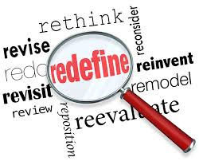
By spending more time learning about the needs of their employees, leaders can set the tone and approach taken by their employees to achieve their organization’s goals. Empathy allows you to create an environment of open communication and more effective feedback.
Leaders should constantly remind themselves that the story in their minds is different from the story playing in the minds of others. It’s only through listening intently to others that these differences can be understood.
Thus teamwork, communication and self-discipline are the cornerstones of team success. The best team leaders are highly skilled in self-analysis, emotional control, and maintaining mental clarity: all this increases their ability to evaluate, comprehend and deal with specific situations, adopting managerial or coaching behaviours accordingly.
Drive, determination and discipline
While drive, determination and discipline are essential internal motivators, they can be taught to the entire team and ultimately the entire organization. In doing so these elements will help create a culture where people can and do make a positive difference. Contd………..
However, in this hour of pandemic, it is empathetic leadership that is most important. Understanding the subordinates, appreciating the why and how of things assume more importance contextually. Leadership is both -defining the long-term vision for the organization and establishing short-term goals for employees - to transform these plans into reality. What distinguishes average to mediocre leaders from those who excel at leading others is the focus and emphasis on fulfilling the collective purpose of creating something meaningful.
To accomplish this, leaders need to understand the inner purpose that drives each of their employees and align that with the organization’s goals. This requires that leaders be more open about their ideas and thinking and asking their employees about their thoughts on it.

Slide 9
The key to drive is universal. It is your desire to succeed. You develop a goal and you strive for it. Determination should be nurtured very early. Determination is what you make of your talents and how you apply them. Your determination will dictate to some degree how far you go in your chosen field. Your determination will steel your pursuit of your goals. Engaging your drive and fuelling your determination comes down to discipline. Discipline is all-consuming. In the workplace, discipline is not simply showing up. It is the rigor that you apply to doing a job and doing it well. It also means not cutting orders for expediency but giving full measure. Discipline is not easy.
While it is necessary to demonstrate drive, determination and discipline, personal success depends upon an ability to create new opportunities as well as to adapt to changing conditions.
A personal anecdote
As an educational administrator and leader of human capital for over two decades I would like to emphasize on the importance of drive, determination and discipline in the kit of every leader.
It is the drive, the passion or the firm belief in oneself that can make a successful leader. To narrate a personal experience, I had just taken over as the Principal when we had to submit the SSR for the third cycle for NAAC. It was the same college where I had served for fifteen years and ten of those as Vice Principal but I needed to win over the confidence of my team as their new leader and convince them that I could take them along with me. This was more so because I had to step into the shoes of a very powerful and successful woman that my predecessor had been. I believed in myself and knew that with my team, we could make it possible.
I was determined to establish myself where I belonged. The management had placed their trust in me and all my efforts were directed to prove them right. The way to do that was through ‘Discipline’.
I ensured that a system was set in place and made it work through a disciplined approach- leading by example. It meant a lot of hard work, building of trust and a lot of patience. It was definitely not easy.
Contd….

Slide 10
Some senior faculty members refused to cooperate. I persuaded them, gave them new roles and involved them more in the process. While most of them came round and began to enjoy the new challenges, a few chose to leave to other institutions. Looking at the larger picture and the overall interest of the institution we took that in our stride and kept focussing on improving performance. That yielded positive results.
The College was reaccredited by NAAC at the highest level, got its autonomous status renewed and was recognised by the UGC as a mentor institution under the Paramarsh scheme as well. All this was possible due to diligent practice of determination and discipline of the entire team thanks to the vision and drive of the leader. The leader and her qualities also saw recognition when positions in top bodies, awards and accolades came her way. This is a testimony to the importance of Drive, Determination and Discipline in the tool kit of every successful leader.
Rethinking Leadership
Keeping drive, determination and discipline in mind will help focus on both the immediate tasks as well as the long-term goals. The future cannot be exactly foretold, but we can create it.
Leaders who assume full responsibility, demonstrate fanatic discipline, empirical creativity, and productive paranoia are those we look up to, consider as role models and it is of them that is said that they leave indelible imprints on the sands of time. Indeed the time has come to rethink leadership 

Slide 11
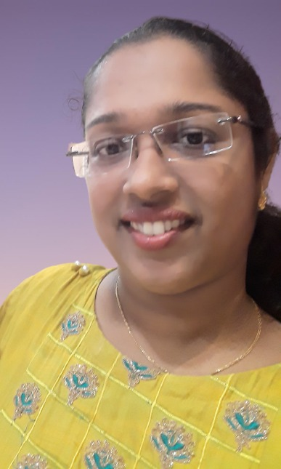
WORK ATTITUDES FOR GROWTH AND EXCELLENCE
MS. FLEUR FERNANDES
FACULTY, SIES COLLEGE OF COMMERCE AND ECONOMICS
(AUTONOMOUS), SION EAST
Hire for attitude, train for skill
- Herb Kelleher (Founder of Southeast Airlines, USA)
There is a lot of focus today on the role of educators in enhancing the employability of their learners. Employability is a triad of knowledge, skills and attitudes. As educators, we undoubtedly work on building the knowledge and skills of the learners in the class. However, attitudes also play a major role in determining employability and scope for future promotions of the candidate. Several industry leaders today value attitudes greater than knowledge and skills of a candidate, especially while selecting candidates for leadership positions. Women form an increasing part of the corporate workforce today in our country. Training our female and male learners with the right attitudes in class today will prepare them for a better tomorrow.
Women who are now in their 50s or more report that when they started their careers, most of their colleagues and managers were male. This has changed drastically during the past two decades. Increase in proportion of women employees and greater participation of women in management has reduced the gender inequalities in the industry. However, women may still face some self-inflicted mental and emotional roadblocks. These roadblocks grow bigger when faced with the tough task of playing the triple role of breadwinner, home maker and mother. As a large number of learners in our class are female, it is imperative that we mould them from now to face future challenges, and also to avoid these roadblocks. Even as educators, whether men or women, we may also possess these undesirable attitudes, but can always work upon them and improve ourselves for the better.
Contd……

Slide 12
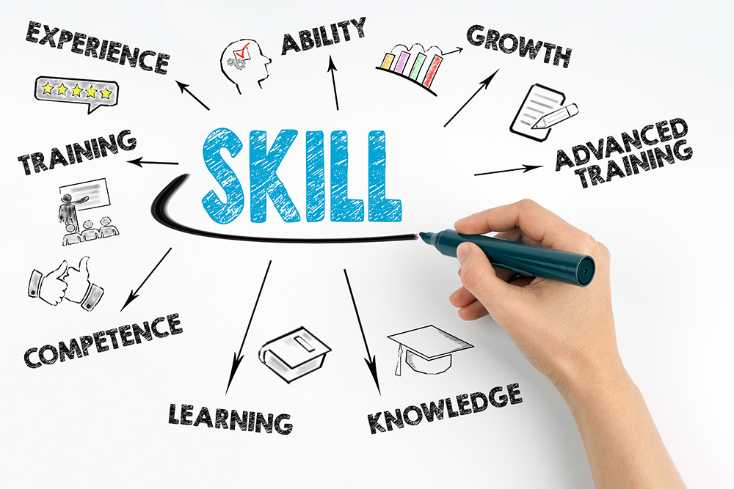
Contd….
Several people say that corporate arena, especially the financial services industry is highly male-dominated. However, my conversations with several women in this industry found that as long as you perform your job well, you are approachable and work well in a team, you will be able to work well with people of any gender.
Women often find it difficult to assert themselves. They find themselves striving for perfection, often creating a fear that they are not performing their current role well enough or do not possess perfect knowledge. While looking at job description of a new vacancy or for a promotion, women tend to focus on what they may not know or not be able to do, rather than on the skills and strengths which they possess.
Thus, many of the challenges faced emanate from within oneself and not because of working in a male-dominated environment.
Married women also tend to lack clarity about when they want to nominate
themselves for a promotion, as fear of being unable to manage new responsibilities alongwith family life bogs them down. It is important for women to plan what role they want to take up next and start putting efforts well in advance to achieve the desired work-life balance.
A woman must pluck the courage to take risks. Taking small risks can enable you to hone your judgement and provide the experience to take larger risks.
You must have a point of view and share your opinion. Be confident and put forth your views not just to those around you but also above you. You must not assume that others at the table know your point of view. It is crucial to make your voice heard.
Each person you meet has something to teach you. Be candid with yourself about your own gaps and order to learn from them. Contd….

Slide 13
Contd…..
It is also important to find yourself a mentor or sponsor. A mentor will help you chart your future career path, guide you to prepare a suitable action plan and also put forward your name for various opportunities. This is especially important in the financial services industry.
Networking can also play a crucial role in determining one’s career success at times. While men often network after work over drinks, women can find opportunities to network at events and conferences.
Many organisations today are working towards maintaining a healthy gender balance within the organisation. Several research reports have concluded that organizations whose top managements are well-balanced in terms of gender mix display better financial performance in terms of Return on Equity than organizations whose Board consists of men only.
Today, many firms offer mentorship and sponsorship programmes for the professional development of their women employees, recognizing its relationship to improved productivity and employee retention. Female employees should follow and participate in such endeavors.
“One has to be passionate about the job, always keep learning, be a good listener and be open to working with people better than you.” - Shanti Ekambaram, President (Consumer Banking), Kotak Mahindra Bank 

Slide 14
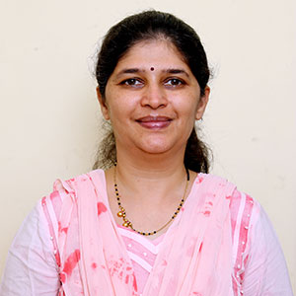
COVID-19, THE TEACHER OF THE CENTURY!!
DR. SWATI KULKARNI
FACULTY– SIES COLLEGE OF MANAGEMENT STUDIES, NERUL
It is always said that life is the Best Teacher, human being remains the student of life till his last breath. Year 2020 proved it right, for all the generations living today on earth and for future generations too. 2020 started with a big news of virus was that killing people across the world. News channels were talking only about the virus, COVID-19 emerged in China and got spread in almost every corner of the globe in NO-TIME. This was something which was really very sudden and not at all expected to the entire world. Countries did not know how to react to this.
COVID-19 as expected landed in India in January-2020. Indian government took strict actions once the bug was found on Indian land and announced lockdown from March 2020. For India, March-April are busy months for various professions. It is financial year end, so people from financial sectors are normally busy in closing their files for the same. It is also the most crucial time for the world of academia.
Academic year for almost every level gets over by April. So, the month of March is the exam time for the student community. Teachers are busy in completing the syllabus and internals. Student are busy in submitting assignments, projects and at the same time preparing for their exams. This is the time when teachers and students are also looking forward for their summer break. But out of nowhere, this COVID-19 makes a special entry to spoil all the plans of the academic world. The Government of India announces lockdown. People were not able to make out what’s happening suddenly. Initially everybody thought it's a matter of time and everything will be back to normal in few days. But destiny had some different plans. Maybe nature has taken a decision to teach a lesson to the people for the ill- treatment they have given to mother earth for years and years. People understood that this monster, COVID-19 is not going soon. Hospitals were getting flooded with patients. Governments requested doctors to work extra hours and join duties immediately.
Contd……..

Slide 15
Contd…..
Police as usual working very hard for safety of their citizens. The academic institution started taking decisions to save their students future from the academic losses. Teachers were giving their best to move from their age-old traditional style of teaching to the new online teaching. With whatever age group they were working very hard to learn different software to keep their online classes productive. With a very small attention span of students in physical classes which may not be more than 10 seconds, keeping their students attentive in online classes itself was a big challenge for teachers’. The teachers are like Theatre actors. They get their motivation from expression they see on their audiences faces. But here, in online classes making them attend the class and keep them attentive was hurting teacher’s spirit. But teachers are known for their dedication towards the duty of imparting the knowledge. This pandemic taught teachers more than the students. Conducting online classes, using different software, keeping online classes more interactive, following online etiquettes to maintain sanctity of the classroom was learnt by the teachers in no time.
People were learning many aspects during pandemic on professional level too. But COVID -19 taught us different lessons on personal level too. The biggest lesson COVID 19 taught all of us is to be independent. Independent from domestic help. It gave us confidence that we can survive without domestic help, we can survive without junk food, we can survive without restaurants. COVID- 19 taught us to keep our home and premises clean without any help. It also showed us importance of family bonding. The pandemic was the only time no one could go out and have fun outside. It was only our home and family members were coming to our rescue. Lot of traditional games had made appearances once again in our lives. Business, Carom and Ludo got popular once again. Netflix and Amazon prime were helping hands in pandemic. Not to forget the Wi-Fi was a backbone of every family
COVID-19 really taught many practices which we had almost forgotten. Mobile apps like zoom, house party, WhatsApp calls took us all in family zone with our family members.
Contd…..

Slide 16
Contd….
On normal days too these apps were available for all of us. But we never even thought of getting connected through video calls with our family and friends. Each one of us was in our own world. We did not bother to get connected to our closed ones. We were not interested to know about them. We were not interested to share our joys and sorrows with them, and we never tried to know if they were going through any tough situations in their life. But when COVID-19 kept us away from them, we understood their value in our life. We suddenly started getting connected to each other. Perhaps, COVID-19 came to teach us the value of privileges we are enjoying but still we keep cribbing that the life is full of problems and stress. COVID-19 made us realize that how we were running behind money and other luxuries but ignoring small joys which are free of cost and easily ever available for all of us. People need to learn a lesson from these tough situations. We had almost forgotten all good practices our parents, grandparents or maybe great grandparents were following. Thinking we are technically much advanced generation, and we need not follow the values taught to us by these people.
We took everything for granted from washing hands after coming back home to taking care of the environment. Everything had gone for a toss!!
COVID-19 has hurt us in many ways but not to forget it has come out as a best teacher for all of us in this pandemic. Thank you, COVID- 19 for showing us the mirror. 

Slide 17
Details of SIESCTD program conducted from January 2021– August 2021
S. No | Title of Program | Date of the Program | No of participants | Beneficiaries | Trainer - Internal / External
1 | Workshop on Advance Excel | 22nd, 24th, 29th, 30th December 2020 & 5th January 2021 | 20 | Non Teaching Staff | Internal
2 | Financial Planning -Way to create extra-ordinary wealth | 5th February 2021 |  | All Staff | External
3 | Teaching Case Studies in Finance Using MS Excel | 27th February 2021 ` | 15 | Teaching Staff | Internal
4 | Webinar - Together we can : Engaging the Power of Synergy | 8th March 2021 | 25 | All Staff | External
5 | "Decoding Online E-filing IT Returns" | 24th April 2021 . | 25 | All Staff | External
6 | Office Module Training | 28th April 2021 | 35 | All Staff | External
7 | Webinar COVINSIGHT - One Step Towards Physical and Emotional Well-Being | 22nd May 2021 | 150 | All Staff, Students, Family Members | External
8 | Office Module Training | 3rd June 2021 | 43 | All Staff | External
9 | Jeevan Jyoti Meditation program - International Yoga Day | 21st June 2021 |  | All Staff and student | External
10 | Self Development program - Aapki Kushi Aapk ke Saath | 9th July 2021 | 104 | Non teaching and Support staff members | External
11 | Webinar on Cyber Crime | 31st July 2021 | 324 | Students | External

Slide 18
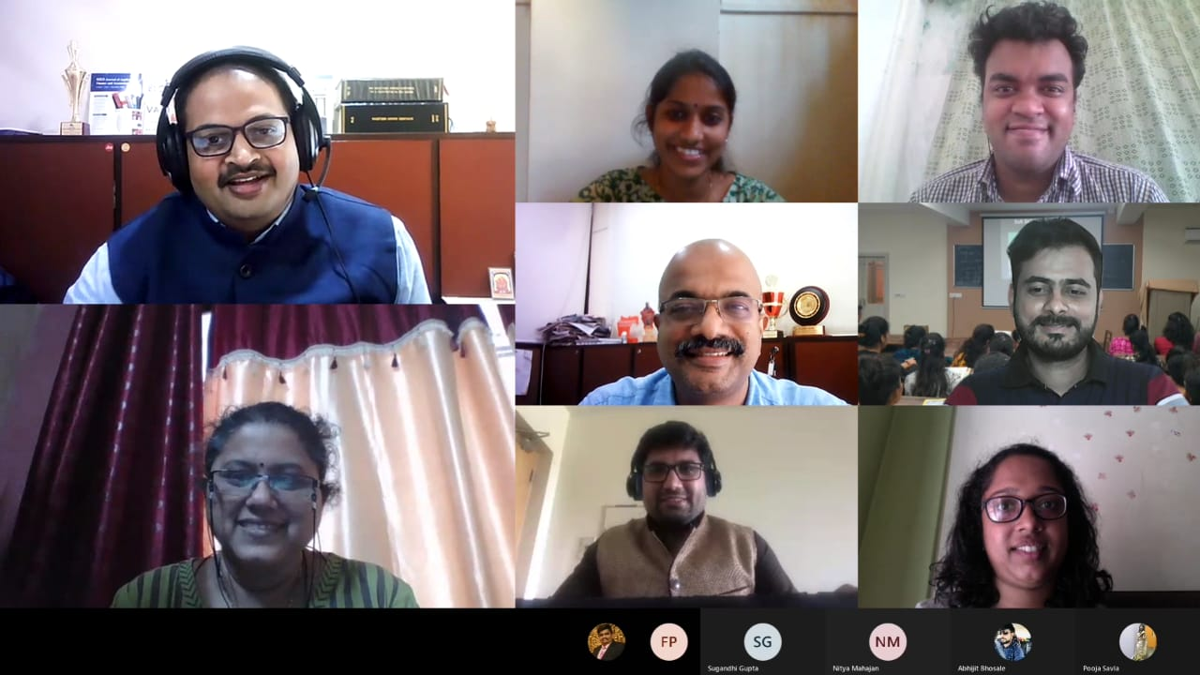
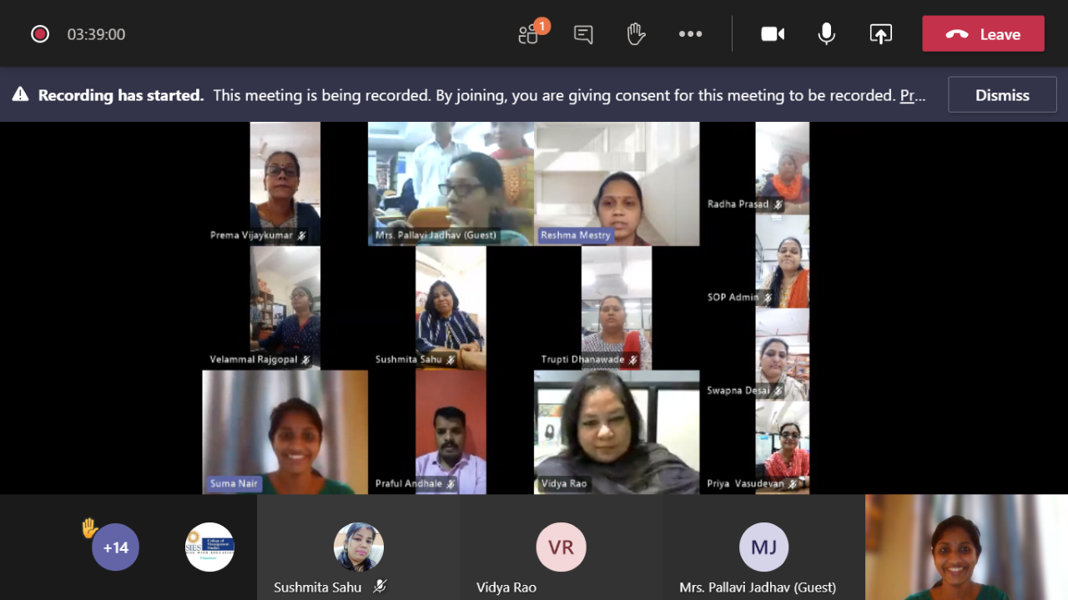
Glimpse of Programme
Teaching Case Studies in Finance Using MS Excel
Webinar - Together we can : Engaging the Power of Synergy
Workshop on Advance Excel for Non-Teaching Staff

Slide 19
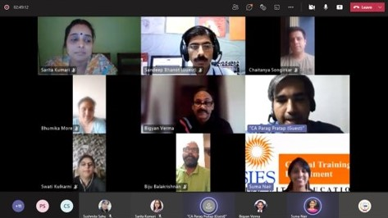
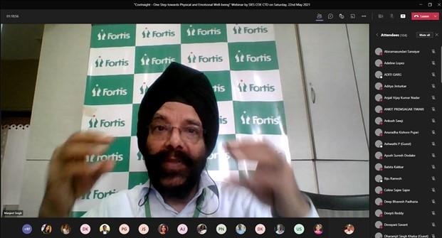
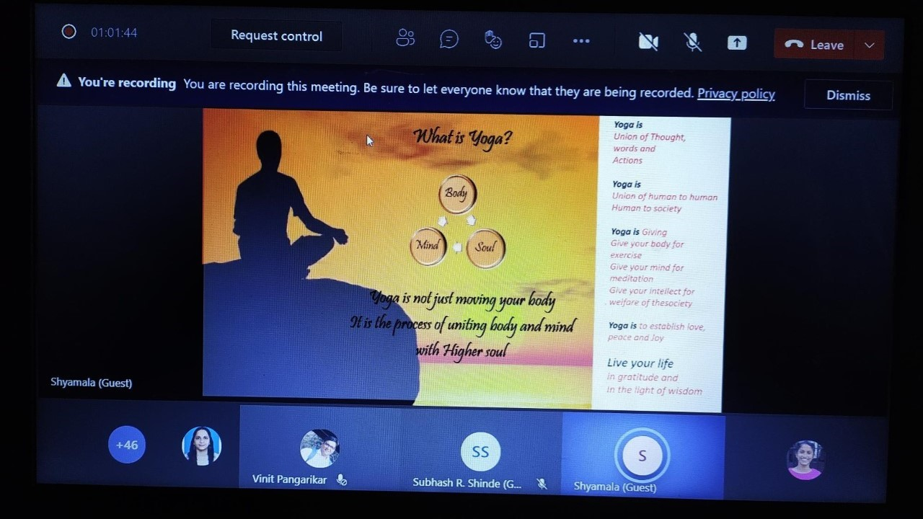
Webinar on -Decoding Online E-filing IT Returns
Webinar COVINSIGHT-One Step Towards Physical and Emotional Well-Being
Online Jeevan Jyoti Meditation program - International Yoga Day

Slide 20
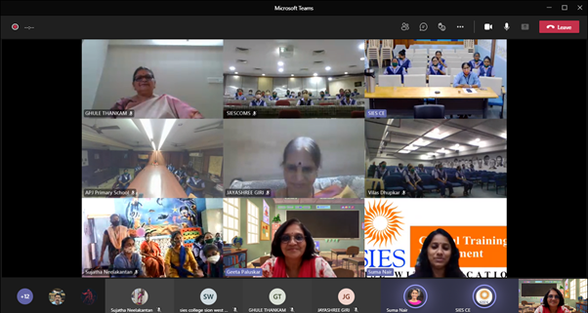
Online Self Development program - Aapki Kushi Aapk ke Saath
Webinar on
Cyber Crime

Slide 21
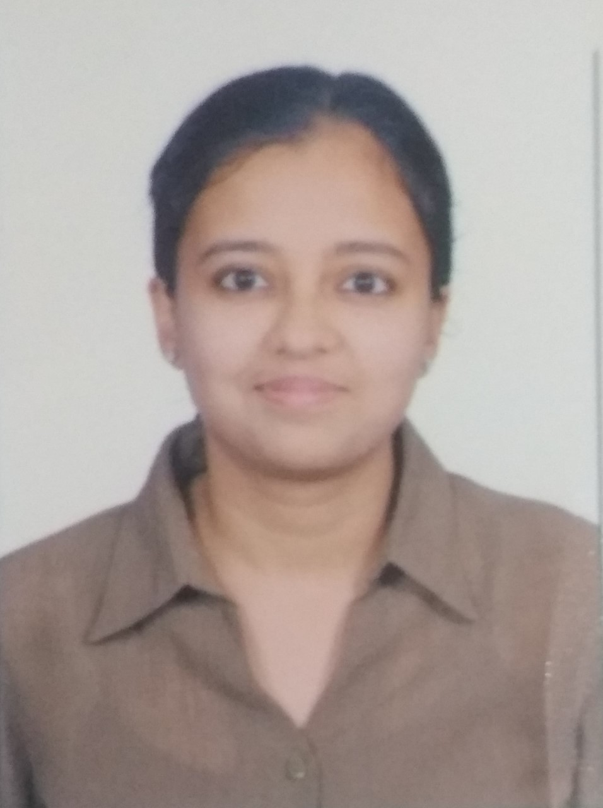
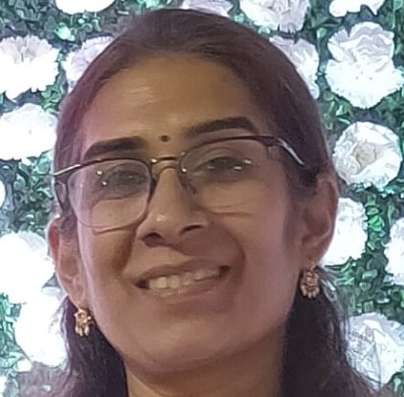
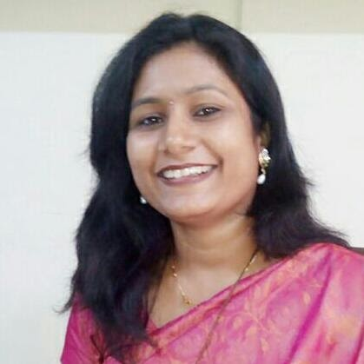
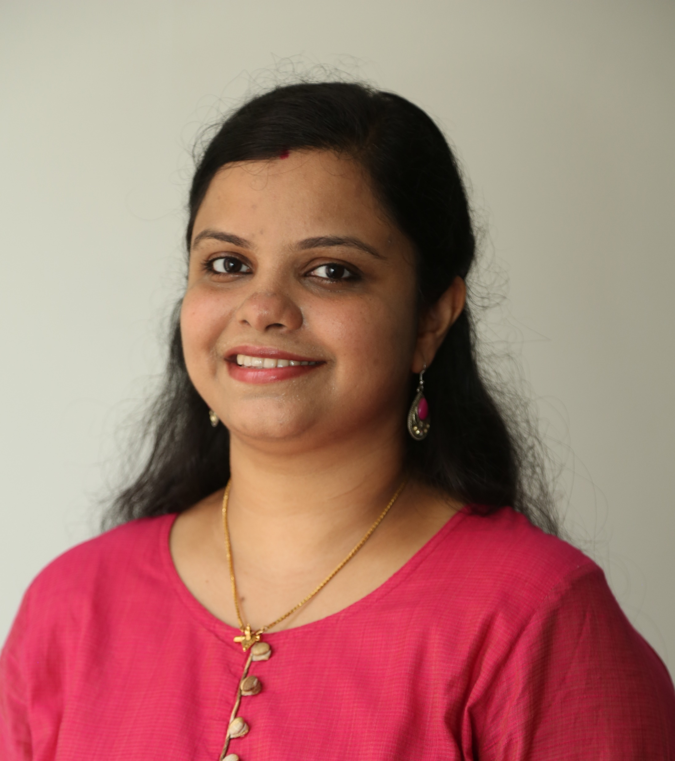
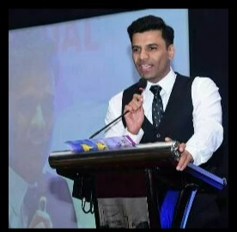
FEEDBACK BY ATTENDEES
TEACHING CASE STUDIES IN FINANCE USING MS EXCEL
The workshop was good learning experience - Sugandhi Gupta -Faculty – SIESCE
Good workshop also please conduct workshop on creating own case studies – Nitya Mahajan – Faculty –SIESASCS(W)
DECODING ONLINE E-FILING IT RETURNS
Well delivered content. The instructor of workshop explained well the entire process of filing -Kalyani N Pampattiwar–Faculty- SIESGST
Relevant topic. The session was very well organized. I would appreciate more webinars on investment etc..-Divya Nair -Faculty - SIESASCN
WEBINAR COVINSIGHT - ONE STEP TOWARDS PHYSICAL AND EMOTIONAL WELL-BEING
Very good insights into Physical and Emotional well being – Faculty-Dr. Vikram Parekh- SIESCOMS
Insightful session. Sincere thanks to Dr Manjit sir and everyone associated with organizing the webinar -Parent of Soham Amiya Roydastidar -SIESASCN
Great session!!!! Very informative!!!!! Worth listening!!!! Thank you so much for this great session!!!! - Student - Tanvi Prakash Palande – SIESASCSW

Slide 22
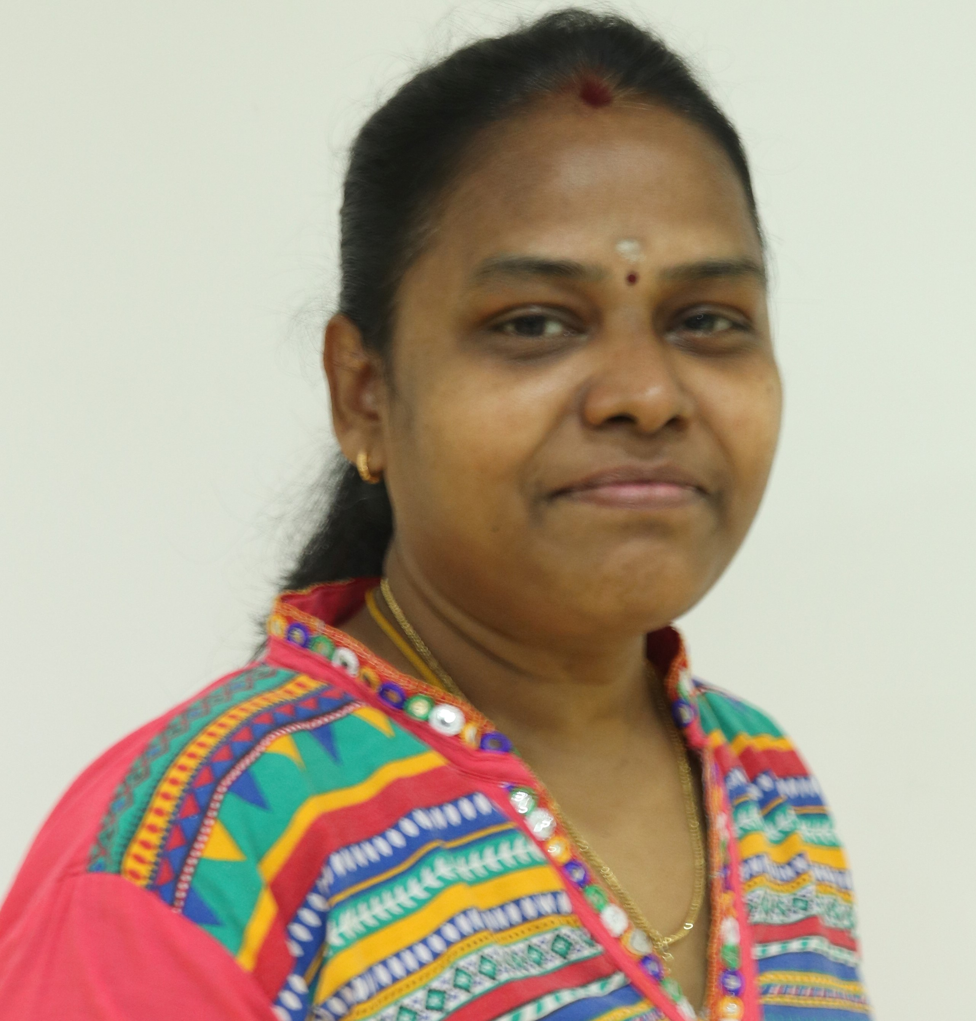
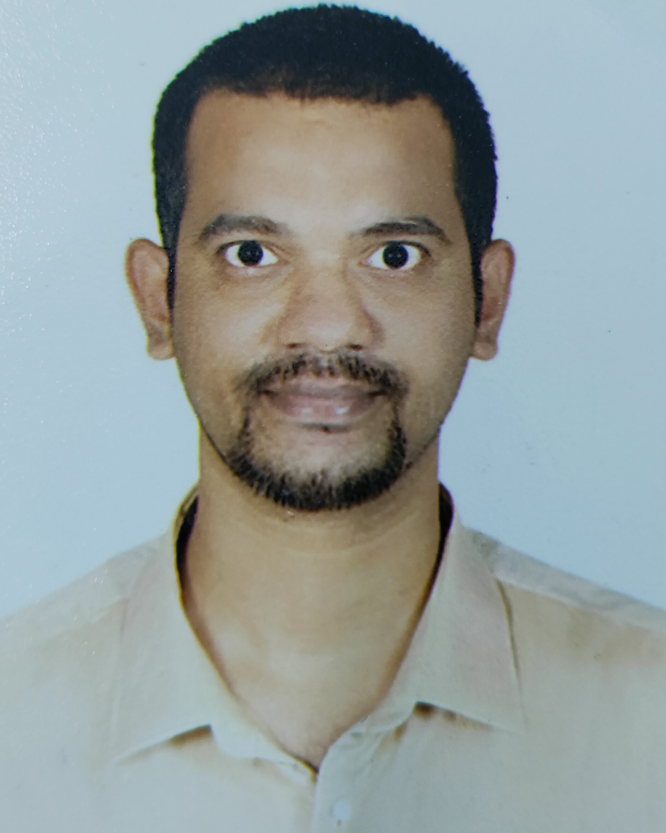
FINANCIAL PLANNING -WAY TO CREATE EXTRA-ORDINARY WEALTH
Interesting and informative program very useful to us- Radha Palanikumar– Office Staff - SIESSOP
Expectations were met with the information shared - Mahesh Balmain - SIES Central Accounts
WEBINAR ON CYBER CRIME – STUDENTS
It was an informative session and also helped in knowing how to save us from such cyber crimes and how to use social media - Gunjan Hinger-SYJC Commerce- SIESASCN
I have gained a lot of knowledge about all cyber crime topics, and I was already waiting for this webinar hence I liked the whole webinar very much - Nadar Muthu Abinesh - BFM -SIESCE
Such a wonderful informative session conduct with us...It was a great session. Thank you all for conduct this session - Kalaivani Adimulam-SY BSC IT-SIESCE
The way Nandini madam explained about cyber crimes was very informative for us. This topic was very important for teenagers like us. Thankyou madam for sparing your precious times for us - Bharati Shankarraj Nadar- BCOM-SIESASCN

Slide 23
UPCOMING WEBINARS / ONLINE WORKSHOP
Awareness on Cyber Crime for Staff members
Orientation to Research
Workshop on Research Writing
Citations and References in research
Online Tools for Effective Research
Publication Ethics
Effective use of Power Presentation for Teaching
Effective use of Power Presentation for Students
Health is Wealth – Food and Diet for Healthy Living
Voice Care
English Language Development for effective Teaching
Developing Communication Skills

Slide 24
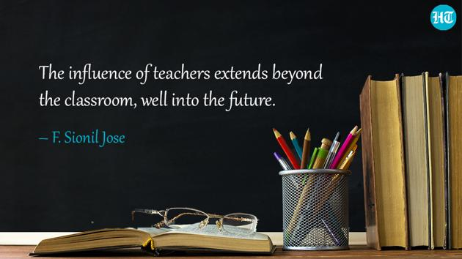
Apart from scholarly articles we invite all the staff members to share their talent work (literary or creative work) with an image and few lines about it. The selected ones will be published in next issue in
“SIES Talent Space”.
Send us by 10th November 2021 on suman@sies.edu.in
SIES Central Training Department
Sri Chandrasekarendra Saraswathy Vidya Puram, Plot I-E, Sector V, Nerul, Navi Mumbai Maharashtra ,India

